Slide 1
Regional Investment Plan
RG Continental Central South
Enrico Maria Carlini
Convenor of ENTSO-E Continental Central South Regional Group
Rome
15th May 2012

Slide 2
Index
Continental Central South Regional Plan
Main drivers
Scenarios
Market studies and results
Network studies and results
Projects of Regional Relevance
Main Messages
Status of the TYNDP 2012 package

Slide 3
ENTSOE releases the TYNDP 2012 package
Consultation phase: 1st March - 26th April
A vision for the future European extra high voltage grid
A non-binding plan, updated every 2 years by ENTSO-E
A modeling of integrated networks
A generation adequacy outlook
A comprehensive and synthetic 8-document suite
TYNDP 2012 Ten-Year Network Development Plan report
SOAF 2012 Scenario Outlook & Adequacy Report
6 RIPs Regional Investment Plans
Official publication June 2012
Sebastien Lepy | 28 March 2012 | Page 3

Slide 4
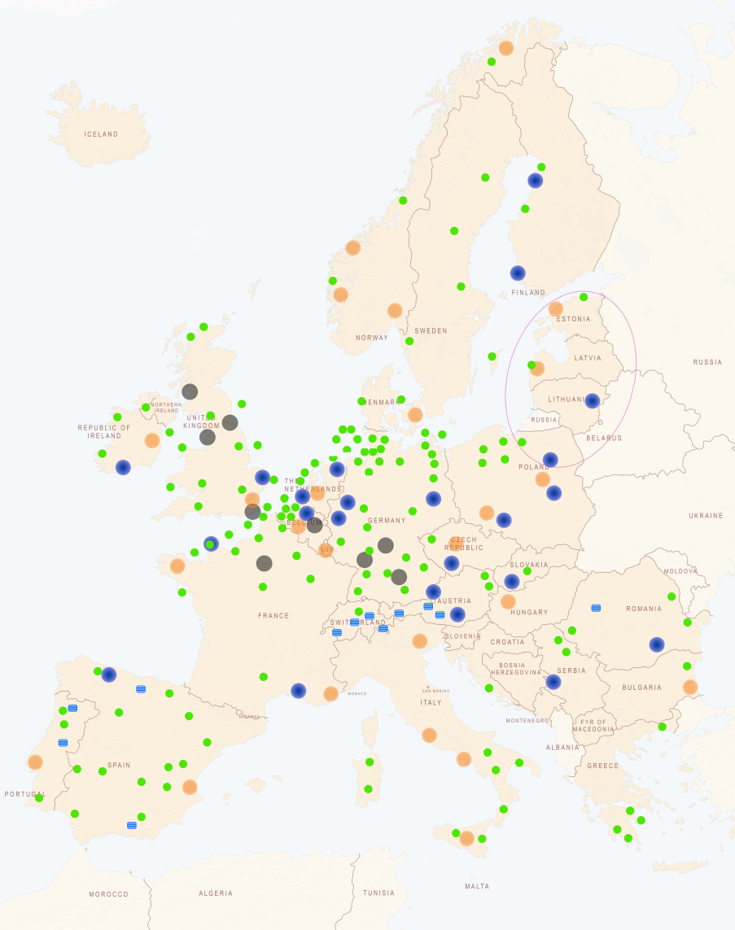
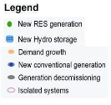
Background scenarios matching EU 2020 goals
Peak load growing by about 8% by 2020
energy efficiency, economic crisis…
switch from fossil fuels to electricity, development of electric devices…
Renewable energies boom providing by 2020 as much as 38% of the electricity demand
mostly wind, photovoltaic
CO2 emissions of the power sector also sink from 26% to 57%
Depending on the share of gas and coal-fired units in the mix
Drivers for grid development
Sebastien Lepy | 28 March 2012 | Page 4

Slide 5
Index
Continental Central South Regional Plan
Main drivers
Scenarios
Market studies and results
Network studies and results
Projects of Regional Relevance
Main Messages
Status of the TYNDP 2012 package

Slide 6
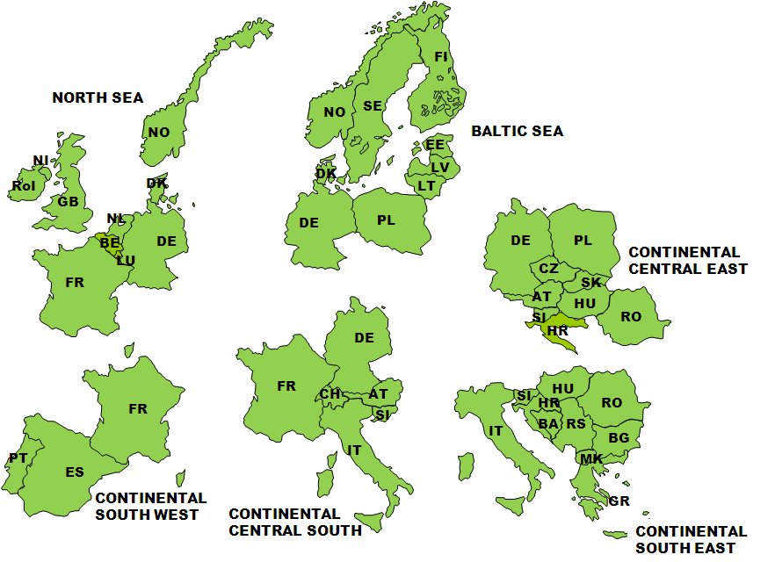
ENTSOE Regional Groups

Slide 7
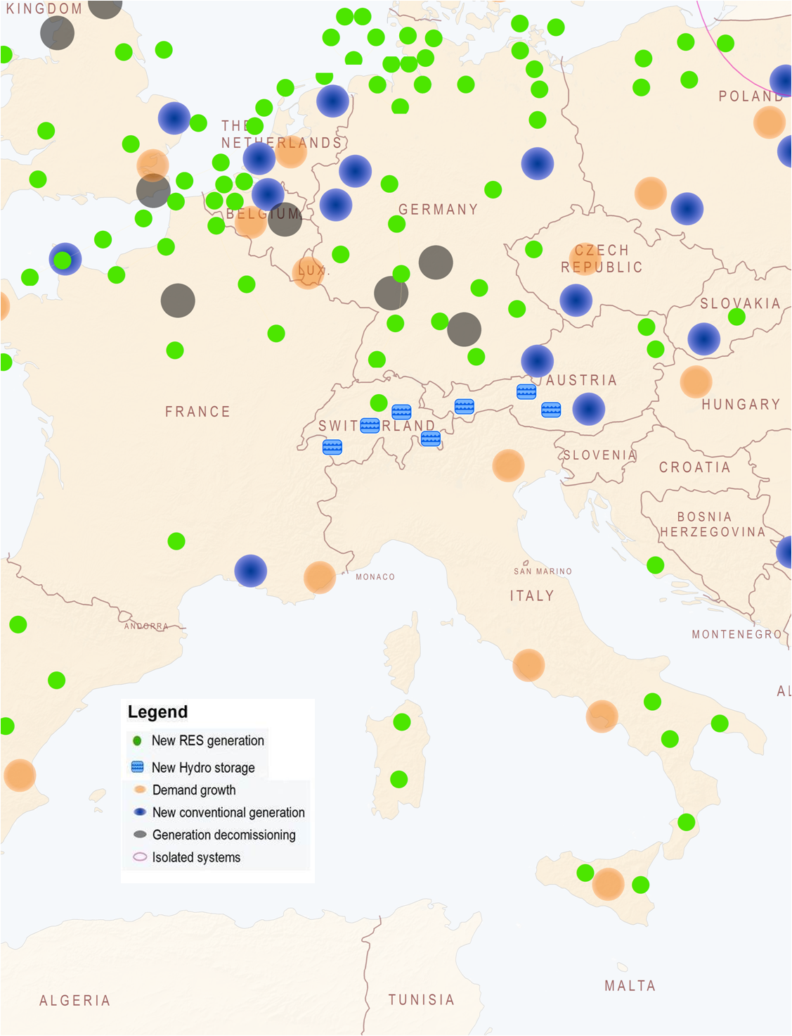
Main drivers in CCS (1/2)
Massive RES connection
  Integration of significant growth of WFs and PVs with an increasing flows from North-South
  More flexible conventional generations is needed (efficient of balancing)
  Offshore interconnections and optimized usage of available hydroelectric facilities will also trigger new investment requirements
Integration of storages plants, mainly hydro
in the Alps region, facilitating an efficient use of RES
  High and fluctuating utilization of the transmission networks due increasing penetration of variable renewable generation
  Transmission network architecture needs to be adapted and expanded to allow transmission over long distances

Slide 8
Main drivers in CCS (2/2)
Nuclear phase out in Germany
  Affections on electricity flows along the whole CCS Region
  Generation and load balance in Germany will become more stressed
  Germany could depend on imports (mainly from Eastern Europe) especially in case of high demand conditions and low RES generation
Power supply of some European cities and regions
  Increasing of cross – border capacity
  Reinforcements will be needed and could become an issue for some cities and regions in Europe (France, Italy, Germany)

Slide 9
Market study of CCS Region
  Two Market tools adopted:
  Promed (IT)
  Antares (FR)
  18 countries simulated
    6 countries in CCS Region
    12 «1st neighbour» countries
  CCS Region: detailed information
  Extended perimeter: PEMD
  Exchanges with rest of EU

Slide 10
EU2020/Sc.B/NuclearPhaseOut: generation and balance
EU 2020:
    Net export from CCS area (+ 44 TWh)
    Strong contribution from:
      Nuclear Source
      Gas source
Dispatchable generation and Net Balance
Nuclear Phase Out:
    Net import from CCS area (- 42 TWh)
    Strong contribution from:
      Coal source
      Gas source
Hydro & Non-Dispatchable generation
All scenarios:
    Strong contribution from:
      Wind source (189-175 TWh)
      Hydro (228-232 TWh)

Slide 11
EU2020/Sc.B/NuclearPhaseOut: main results
Impact on the generation breakdown:
In all scenarios, decrease of gas generation in Italy that is replaced by:
    EU2020: French nuclear and German gas
    ScB and NuclearPhaseOut: German coal + coal from the 1st neigbours (PL, NL, GB)
CO2:
    EU2020: decrease of 9 Mtons (gas ⬄ nuclear + gas)
    ScB (resp. NuclearPhaseOut): increase of 9 (resp.12) Mtons (gas ⬄ coal)
Generation cost savings:
For all modelled countries: -540 M€ (NuclearPhaseOut) to -730 M€ (scenario B)
Spillage:
    EU2020: spillage in Germany - LT reinforcements are sufficient to reduce significantly spillage
    ScB and NuclearPhaseOut: no spillage

Slide 12
Network study of CCS Region: cases
Typical snapshots considered in order to maximise the flows and cross-border exchanges
Winter 2020 low load, high RES generation
Winter 2020 high load, low RES generation
Load-flow simulations have been conducted for each of these configurations
High Load and Low RES case
Low Load and High RES case
Notes:
12

Slide 13
Index
Continental Central South Regional Plan
Main drivers
Scenarios
Market studies and results
Network studies and results
Projects of Regional Relevance
Main Messages
Status of the TYNDP 2012 package

Slide 14
Focus on CCS Region
34 projects
21,800 km total length in CCS Region
    ∼ 8,700 km on Mid Term
    ∼ 13,100 km on Long Term
About € 52 billions of investments considering projects of pan-European significance
    Mid Term investments: ∼ 19,300 Mil€
    Long Term investments: ∼ 33,500 Mil€
100 MtCO2/y savings -> 2nd highest contribution in ENTSO –E perimeter with BS and CCE
About 615 Mln€ of cost savings in EU2020

Slide 15
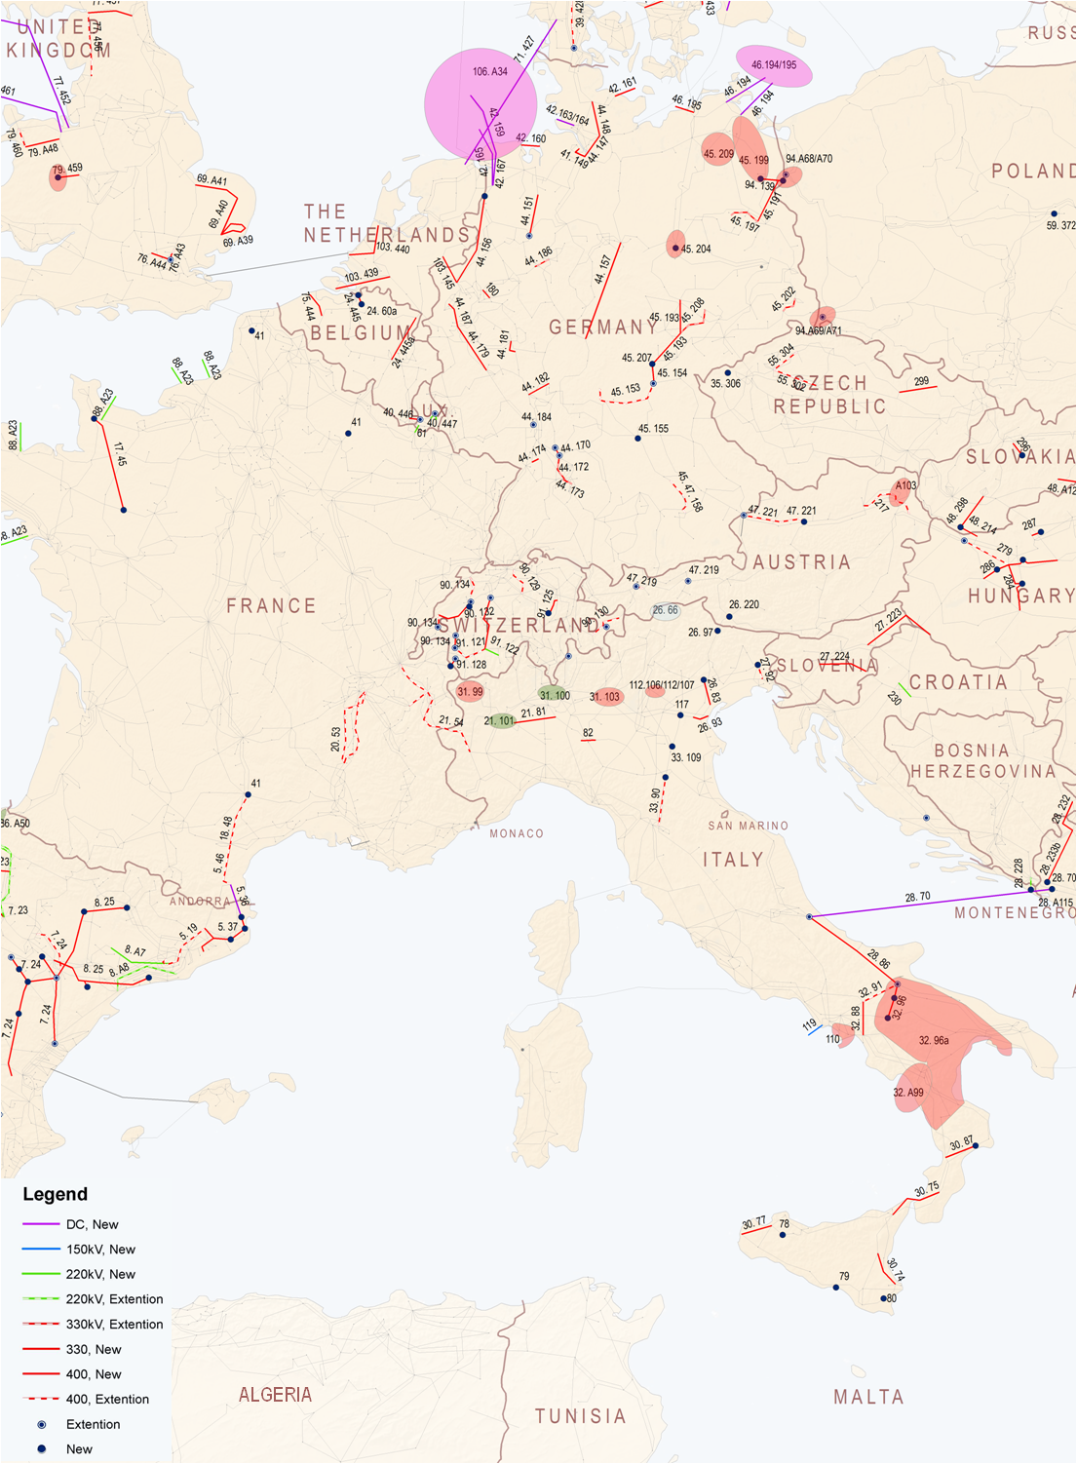
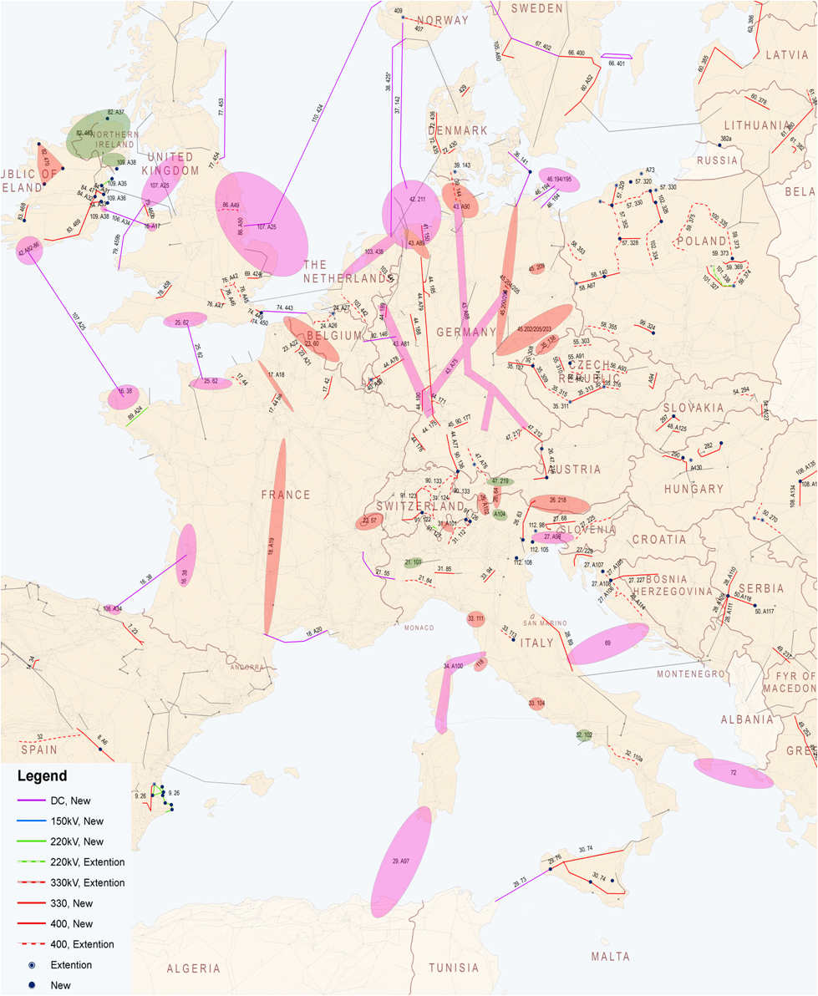
Projects of Regional relevance
Mid Term Investments
Long Term Investments

Slide 16
Project assessment
Every project valuated against 9 criteria
Basis for further selection of
Projects of Common interest
+ technical description
+ monitoring
Sebastien Lepy | 28 March 2012 | Page 16

Slide 17
Index
Continental Central South Regional Plan
Main drivers
Scenarios
Market studies and results
Network studies and results
Projects of Regional Relevance
Main Messages
Status of the TYNDP 2012 package

Slide 18
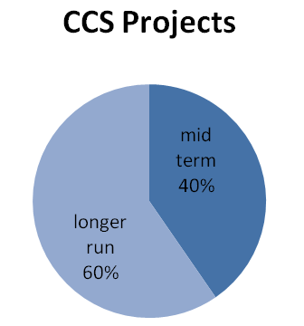
Expected benefits of CCS projects (1/2)
The projects
Medium Term: 40% - Long Term: 60%
Investments: 62% AC technology - 38% DC technology
AC investments: 69 % are new infrastructures - 31% are new lines upgrading/uprating;
DC: 95% are new infrastructures
Social & economic welfare Indicator
40% of planned projects are expected to reserve >100M€/y when commissioned

Slide 19
Expected benefits of CCS projects (2/2)
RES integration
20% projects of CCS RG contribute to direct RES connection
45% projects of CCS RG accommodate inter-area flows trigged by RES
Security of Supply
Eliminate risk of SoS in next 10 years: 33%
Improving SoS in next 10 years: 58%
CO mitigation
63% CCS projects take part in CO mitigations

Slide 20
THANK YOU FOR YOUR ATTENTION !

